Slide 1
Graph Search in C++
Andrew Lindsay

Slide 2
Overview
- Review of search algorithms (if needed)
- Pseudocode
- Implementation
- Timing tests

Slide 3
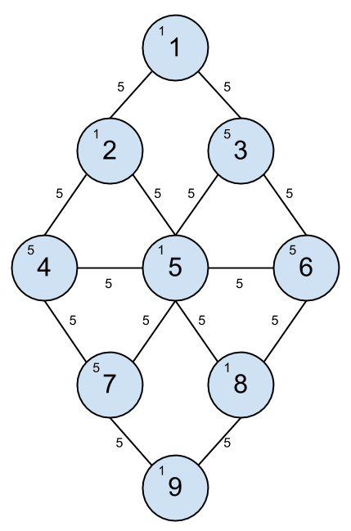
Searches Used
- Depth First
- Breadth First
- Greedy Best First
- A*

Slide 4
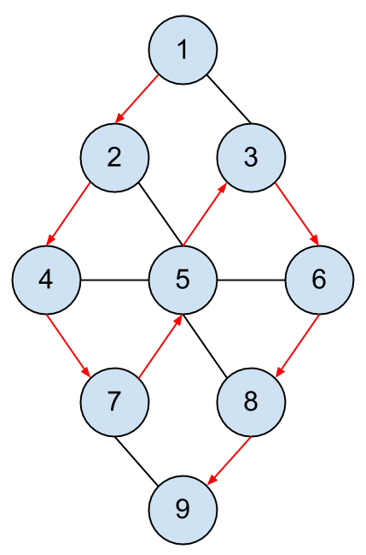
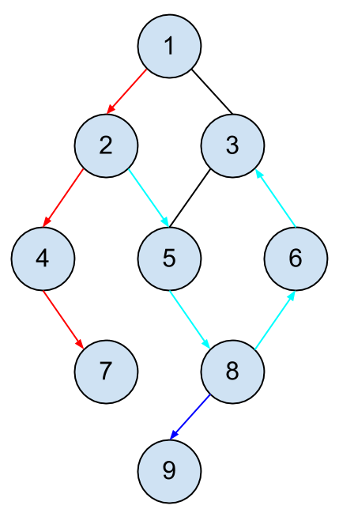
Depth First Search

Slide 5
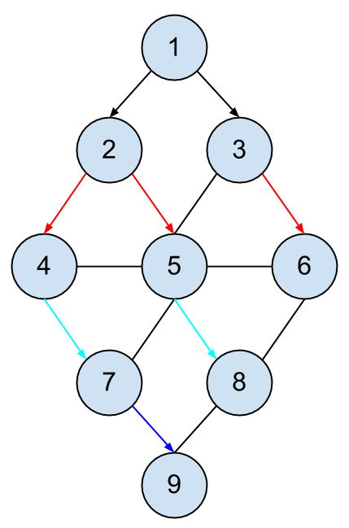
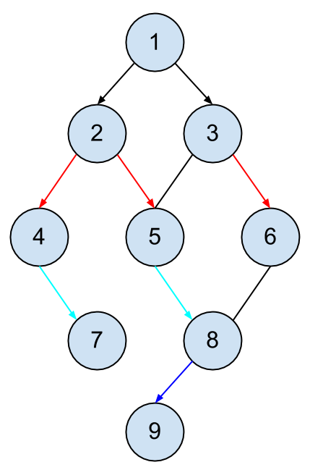
Breadth First Search

Slide 6
Greedy Best First Search

Slide 7
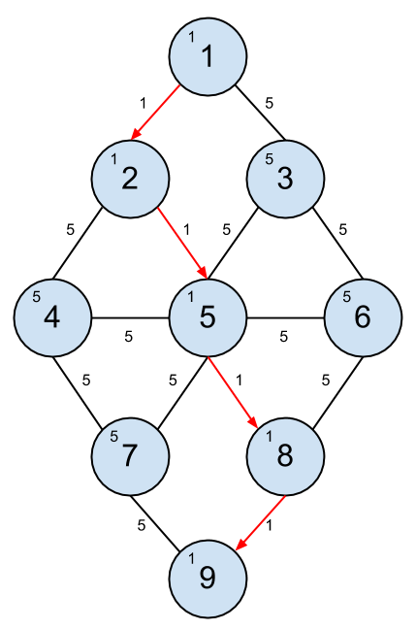
Greedy Best First Search

Slide 8
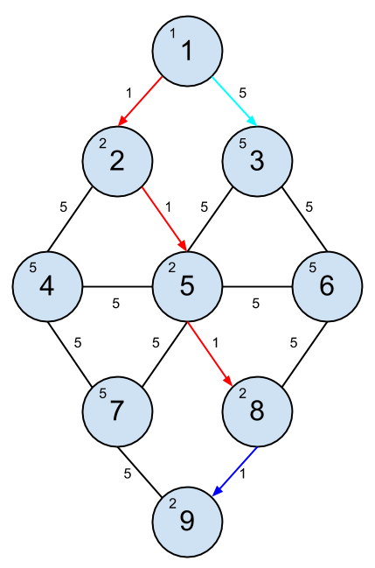
A* Search

Slide 9
DFS
bool DoSearch(node curr)
add curr to path, set path on curr
add curr to closed list
return true if at target of search
fetch all vertices connected to curr
for each vertex fetched
if not already visited
add to search tree
prepend to open list
let nextNode be first node in open list
return true if DoSearch( nextNode )
otherwise return false

Slide 10
BFS
bool DoSearch(node curr)
add curr to path, set path on curr
add curr to closed list
return true if at target of search
fetch all vertices connected to curr
for each vertex fetched
if not already visited
add to search tree
append to open list
let nextNode be first node in open list
return true if DoSearch( nextNode )
otherwise return false

Slide 11
GBFS
bool DoSearch(node curr)
add curr to path, set path on curr
add curr to closed list
return true if at target of search
fetch all vertices connected to curr
for each vertex fetched
if not already visited
add to search tree
append to open list
sort open list by heuristic (ascending)
let nextNode be first node in open list
return true if DoSearch( nextNode )
otherwise return false

Slide 12
A*
bool DoSearch(node curr)
add curr to path, set path on curr
add curr to closed list
return true if at target of search
fetch all vertices connected to curr
for each vertex fetched
if not already visited
add to search tree
add to open list
else if new path less expensive
change parent in search tree
re-add to open list
remove from closed list

Slide 13
A* continued
sort open list by sum(heuristic+path cost) (ascending)
let nextNode be first node in open list
return true if DoSearch( nextNode )
otherwise return false

Slide 14
Implementation
Three base classes:
- Tree, Graph, Search
Classes inheriting from Search:
- AStar, DFS, BFS, GBFS

Slide 15
Graph
Tree
Search
Vertex and Edge structs.
Node struct.
DoSearch method.

Slide 16
Timing Tests
Random graphs, varying vertex amounts, average of five edges per vertex.
For sizes 50 - 500 in increments of 50.
700 trials of each search with 10 different graphs at each increment (no A*).

Slide 17
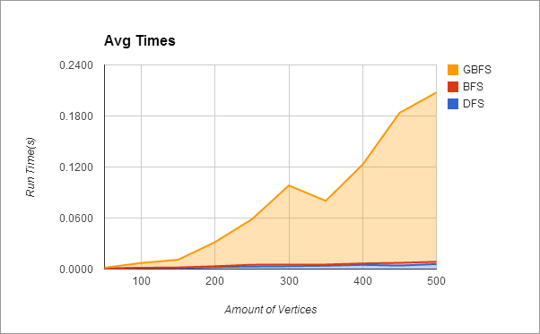
Results
DFS, BFS roughly same scaling.
GBFS far out scales others in timing:
- This makes sense for random graphs

